Slide 1
Digital Platform
Frontend
2
3
Mocking Up
1
User Interface Programming
Functional Programming
UX/UI Design
System Analyze
Login
Dashboard
Register
User/Customer Form
Waiting List
Ending
Button
Ordering
Sign up
QR-code Gen
Date & Time
Login/Logout
Database Design
Backend
Adjustment
Deploying
6
5
Database/Synchronization
Database Design
Dec
Jan
Feb
Database Development
1
4
Finish:
17/2/2566
Synchronization
4
Finish: 17/1/2566
Finish: 23/2/2566
2
5
Finish: 17/1/2566
Finish: 23/2/2566
3
6

Slide 2
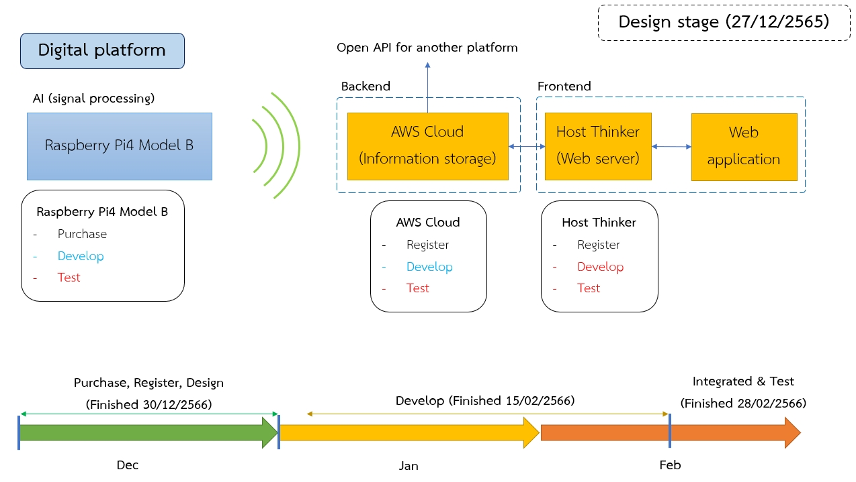
ReactJS
Frontend
Backend
Test

